Slide 2
Psalm 83 War

Slide 3
Edom
Ishmaelites
Moab
Hagarines
Gebal
Ammon
Amalek
Philistines
Tyre
Assur
Lot

Slide 4
Edom
Ishmaelites
Moab
Hagarines
Gebal
Ammon
Amalek
Philistines
Tyre
Assur
Lot
S.Jordan (Palestinians)
Western Saudi Arabia
C.Jordan (Palestinians)
Egypt (Muslim Br’hood)
N.Lebanon (Hezballah)
N.Jordan (Palestinians)
Negev
Gaza (Hamas)
S.Lebanon (Hezballah)
Assyria (ISIS)
Moab & Ammon

Slide 5
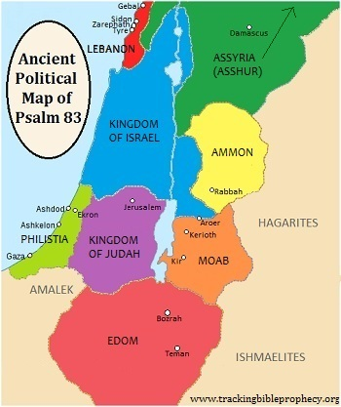

Slide 8
EGYPT??

Slide 9
Israel Will Defeat These Nations
Psalm 83:17

Slide 10
Israel Will Defeat These Nations
Psalm 83:17 and Will Expand Her Borders!
Isaiah 49:19-26
Isaiah 54:2-3
Micah 7:11-19

Slide 11
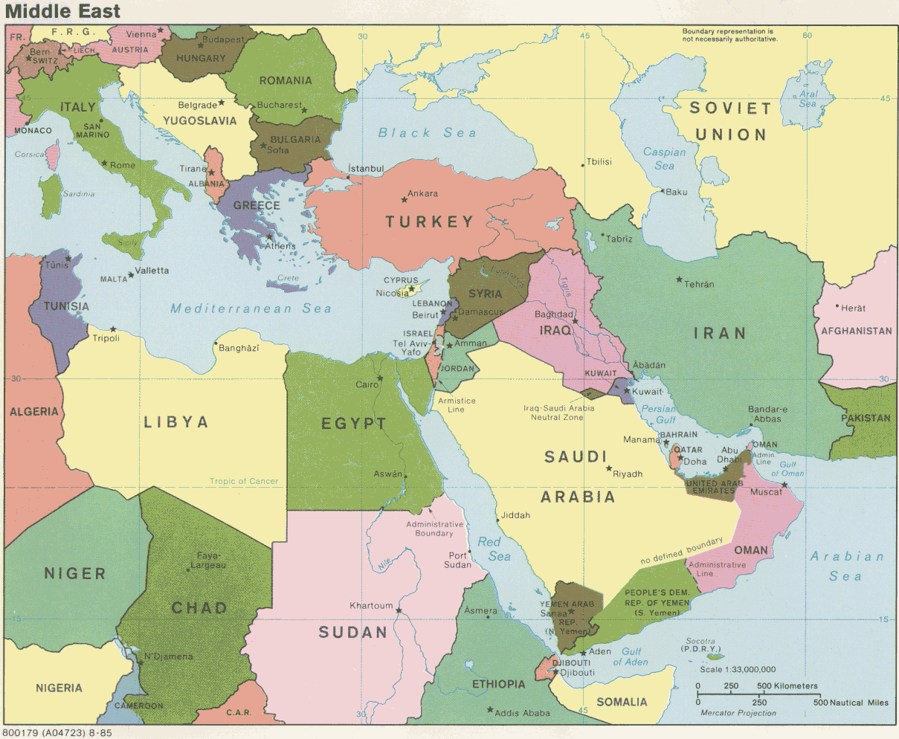
Israel Today

Slide 12
Israel After Psalm 83

Slide 13
Then Comes …..
Gog Magog War
Ezekiel 38 & 39

Slide 14
Ezekiel 38 Nations
Gog (Rosh)
Magog
Meshek
Tubal
Persia
Cush
Put
Gomer
Togarmah

Slide 15
Ezekiel 38 Nations
Gog (Rosh)
Magog
Meshek
Tubal
Persia
Cush
Put
Gomer
Togarmah
N. Of Black Sea
Scythians (“-Stans”)
Within Turkey
Within Turkey
Iran
Sudan
Libya & Westward
Within Turkey
Within Turkey

Slide 16
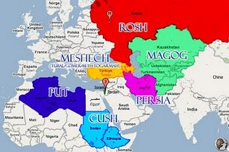

Slide 17
New Israel

